Slide 1
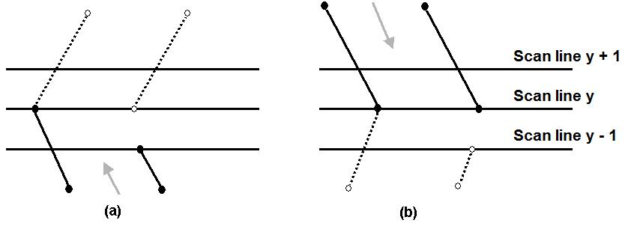
The Scan-Line Polygon Fill Algorithm
Dealing with vertices
When the endpoint y coordinates of the two edges are increasing, the y value of the upper endpoint for the current edge is decreased by one (a)
When the endpoint y values are decreasing, the y value of the next edge is decreased by one (b)

Slide 2
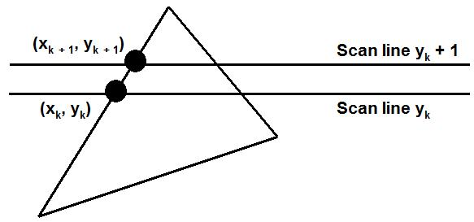
The Scan-Line Polygon Fill Algorithm
Determining Edge Intersections
m = (y_{k+1} – y_{k}) / (x_{k+1} – x_{k})
y_{k+1} – y_{k} = 1
x_{k+1} = x_{k} + 1/m

Slide 3
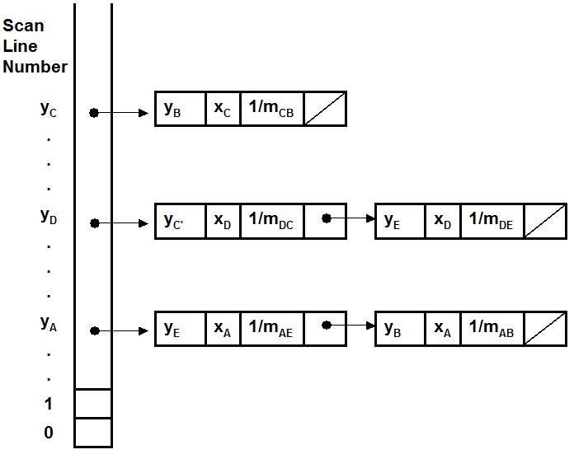
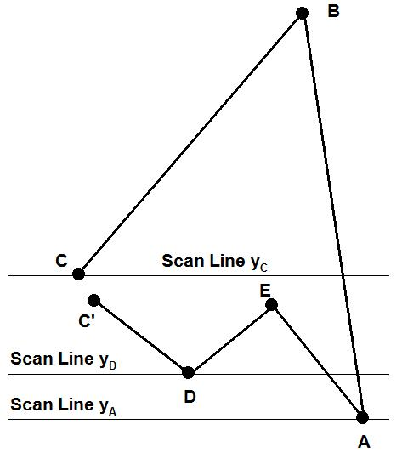
The Scan-Line Polygon Fill Algorithm
Each entry in the table for a particular scan line contains the maximum y value for that edge, the x-intercept value (at the lower vertex) for the edge, and the inverse slope of the edge.

Slide 4
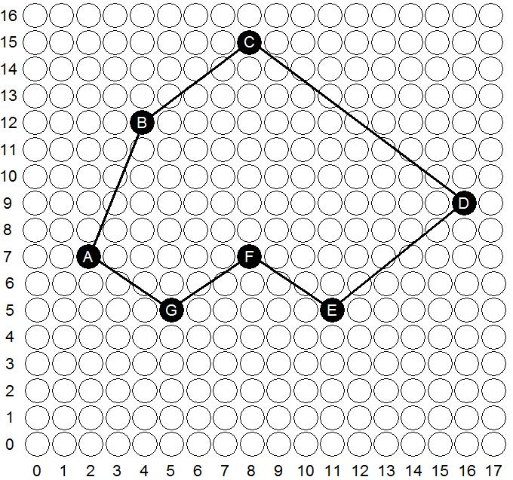
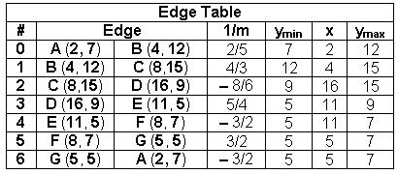
The Scan-Line Polygon Fill Algorithm
(Example) Polygon = {A, B, C, D, E, F, G}
Polygon = {(2, 7), (4, 12), (8,15), (16, 9), (11, 5), (8, 7), (5, 5)}

Slide 5
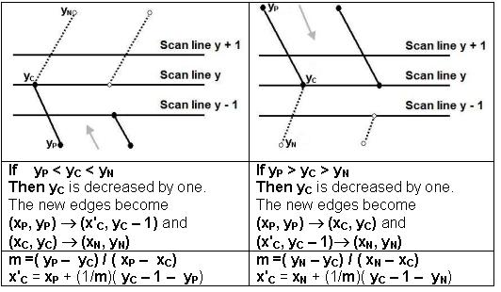
The Scan-Line Polygon Fill Algorithm
(Example)

Slide 6
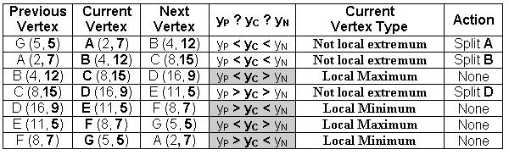
The Scan-Line Polygon Fill Algorithm
(Example)
Vertex A should be split into two vertices A' (x_{A'}, 6) and A(2, 7)
m =( 5 – 7)/( 5 – 2) = – 2/3
x'_{A} = 5 + (–3/2)( 7 – 1 – 5) = 7/2 = 3.5 ≅ 4
The vertex A is split to A' (4, 6) and A(2, 7)

Slide 7
The Scan-Line Polygon Fill Algorithm
(Example)
Vertex B should be split into two vertices B' (x_{B'}, 11) and B(4, 12)
m =( 7 – 12)/( 2 – 4) = 5/2
x'_{A} = 2 + (2/5)( 12 – 1 – 7) = 18/5 = 3.6 ≅ 4
The vertex B is split to B' (4, 11) and B(4, 12)

Slide 8
The Scan-Line Polygon Fill Algorithm
(Example)
Vertex D should be split into two vertices D(16, 9) and D' (x_{D'}, 8)
m =( 5 – 9)/( 11 – 16) = 4/5
x'_{D} = 11 + (5/4)( 9 – 1 – 5) = 59/4 = 14.75 ≅ 15
The vertex D is split to D(16, 9) and D' (15, 8)

Slide 9
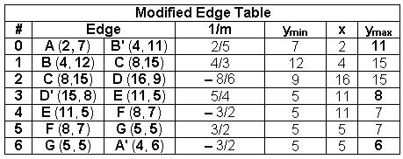

The Scan-Line Polygon Fill Algorithm
(Example)

Slide 10
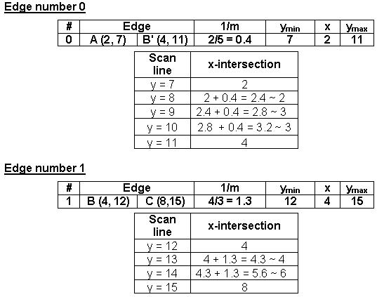
The Scan-Line Polygon Fill Algorithm
(Example)

Slide 11
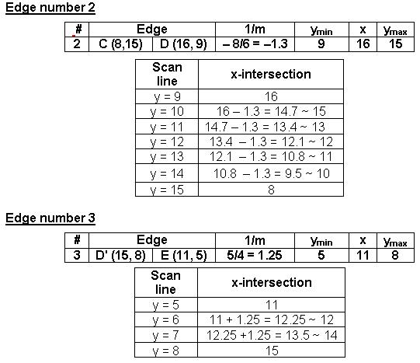
The Scan-Line Polygon Fill Algorithm
(Example)

Slide 12
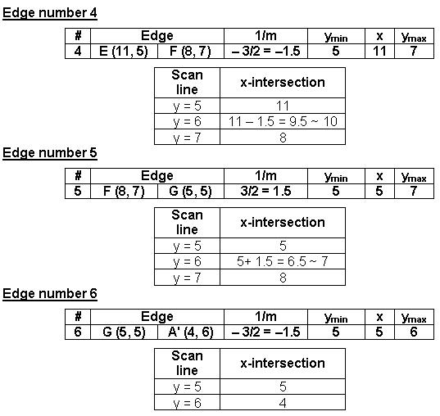
The Scan-Line Polygon Fill Algorithm
(Example)

Slide 13
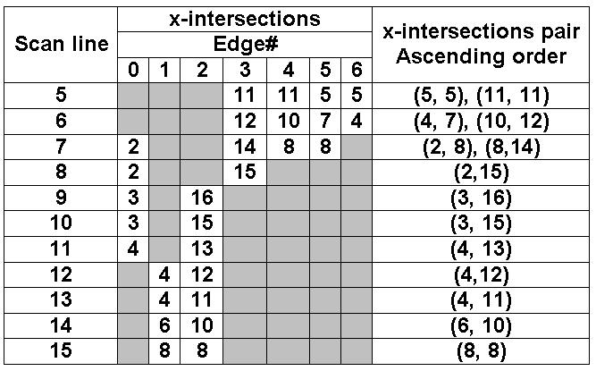
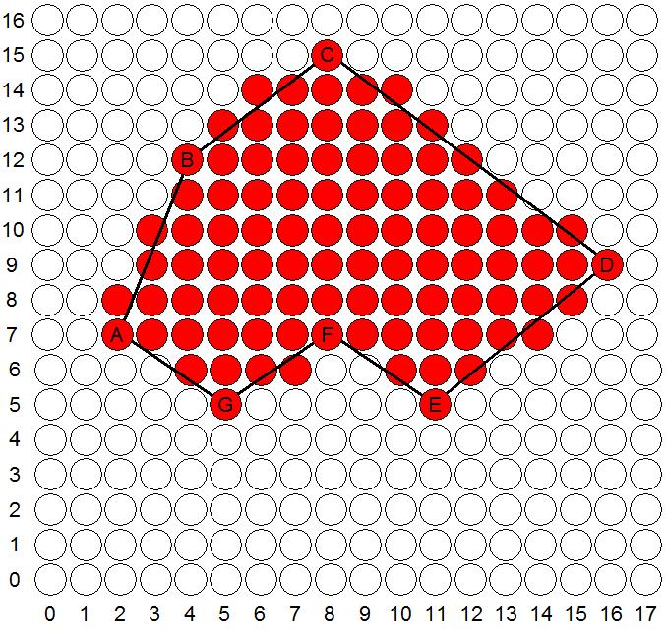
The Scan-Line Polygon Fill Algorithm
(Example)

